Slide 1

X-Files:
A Data Challenge for Space Domain Awareness
https://xfiles.llnl.gov
Robert Armstrong, Dan Merl, Joshua Meyers, Kerianne Pruett, Eddie Schlafly, Michael Schneider
March 2022
Data version: v3.0
xfiles@llnl.gov

Slide 2
X-Files: A data analytics competition for SDA
The challenge requires blind analysis of curated data sets (‘branches’) for distinct tasks in an optical LEO SDA pipeline:
X-Files participants submit formatted analysis results that get scored and populated onto the X-Files dashboard
https://xfiles.llnl.gov
Adding your score to the X-Files leaderboard is a great way to show off your SDA algorithms and get attention for your product!
X-Files Challenge
Sidereal / Target Tracking
Calibration
Detection
Initial Orbit Determination
Branches
SDA Tasks
Downrange Location Prediction
State Vector Estimation
Sidereal / Target Image Tracks
Calibration & Detection
Competition
State Vector Estimation & Downrange Location Prediction
A community competition to advance SDA data analytics

Slide 3
The X-Files participation process
Curated data sets organized in 'branches'
Participants download data branches and run their algorithms
Participants return algorithm results in specified file format
X-Files scores participant results relative to private 'truth' information
Submission results are displayed and compared in an interactive dashboard
Opportunity for SDA algorithm creators to refine their products based on X-Files scores and resubmit. The truth information is never supplied to participants.
Download data, run your algorithm, and submit results to earn a score

Slide 4
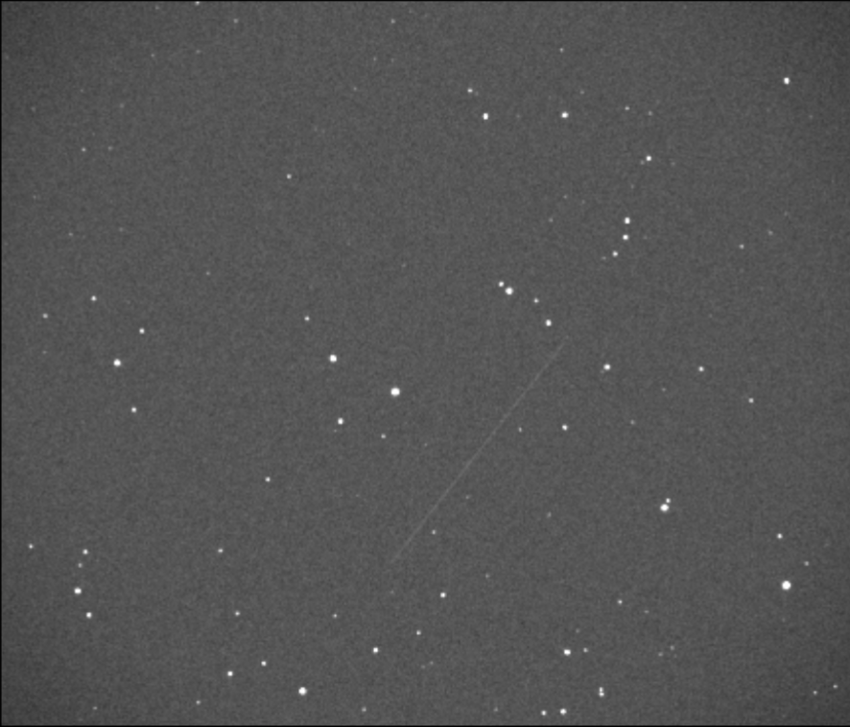
Branches in X-Files v3.0
"Target" Tracking
Simulated images of ground-based target tracking observations for testing locating RSOs in images.
"Sidereal" Tracking
Simulated images of ground-based sidereal tracking observations for testing locating RSOs in images.
"IOD" – Target Tracking
Tracks of optical, angle-only observations of varying lengths for testing IOD predictions.
"Target Track" and "Sidereal Track"
Multiple simulated images per target at distinct times, creating a "stack" of images for observations along a track.
These branches test on the full pipeline from detecting/tracking, to IOD predictions
Example Sidereal branch image
Participants may run as many algorithms on as many branches as they like

Slide 5
The X-Files ‘branches’ test distinct components of an SDA data analysis pipeline
SDA pipeline steps
Detection
Calibration & Registration
Track Formation
IOD
Covariance Estimation
Track Linking
Prediction / Orbit Refinement
X-Files branches
Target tracking
Detection
Calibration
(v3)
IOD branches to be connected to detection branches in v3
IOD
IOD
(v3)
???
Sidereal tracking
Detection
Calibration
(v3)
X-Files scoring metrics
Completeness
False positive rate
Position error
Magnitude error
Root mean square state error at epoch
Propagated state error downrange (5, 15, 30, 60 min)
Covariance statistics

Slide 6
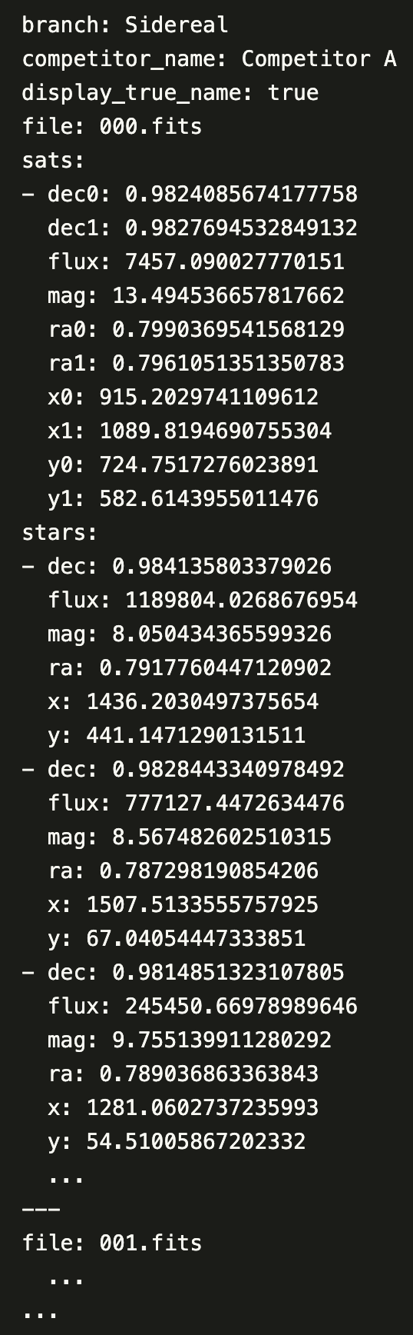
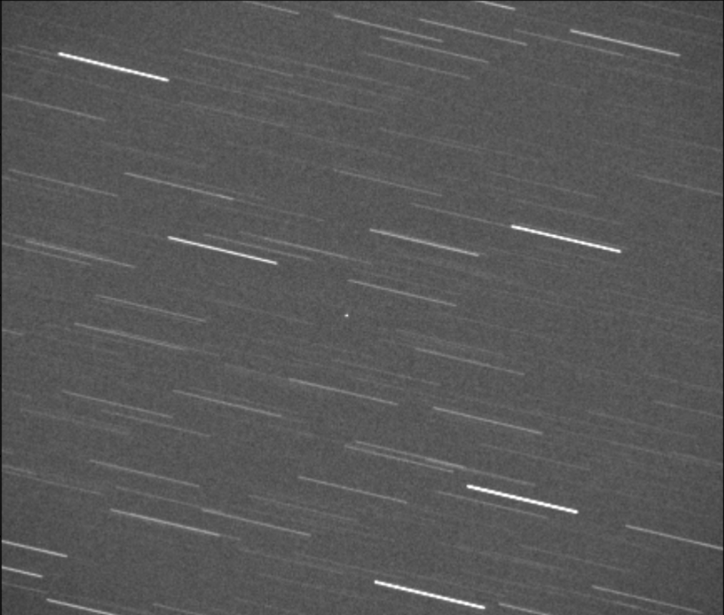
Target/Sidereal Branch Structure
3) Competitor generates a submission file that gets returned for a score
1) Competitor is supplied
set of images (per branch)
2) Competitor uses their algorithm to determine the information of interest
Example Target branch image
The "Target" and "Sidereal" branches test the competitor on detection and calibration tasks

Slide 7
Target/Sidereal Branch Information Tests ability to detect targets within ground-based optical images
Branch Simulation
Images include optical distortion, variable surface brightness background, and vignetting, and cover a range of exposure times.
Star positions and fluxes are derived from Gaia DR2.
Scores (based on type of submission information)
Notes
Regardless of branch, each target is treated as a streak
Supplying star information is optional
Minimum submission required to receive a score:
x0, x1, y0, y1, and flux for each target in an image, for ALL images
x0, x1, y0, y1, flux
Detection scoring
Tests ability to locate target in image
ra0, ra1, dec0, dec1, mag
Calibration scoring
Tests ability to transform detection into sky quantities

Slide 8
Target/Sidereal Branch Scoring Metrics
Target
Sidereal
Calibrate
Detect
Calibrate
Detect
For each branch and task combination,submissions will receive the following scores:
Completeness:
The number of true satellites found in the submissions, divided by the number of true satellites
completeness = (n_true_found / n_true)
False positive rate:
The number of false positive detections found in submissions (that could not be associated with a true satellite), over the number of true satellites
fpr = 1 - (n_associated / n_true )
Position error:
Root mean square error (RMSE) of submitted position
Magnitude error:
Root mean square error (RMSE) of submitted magnitude
Detection scores use x/y/flux and calibration scores use ra/dec/mag

Slide 9
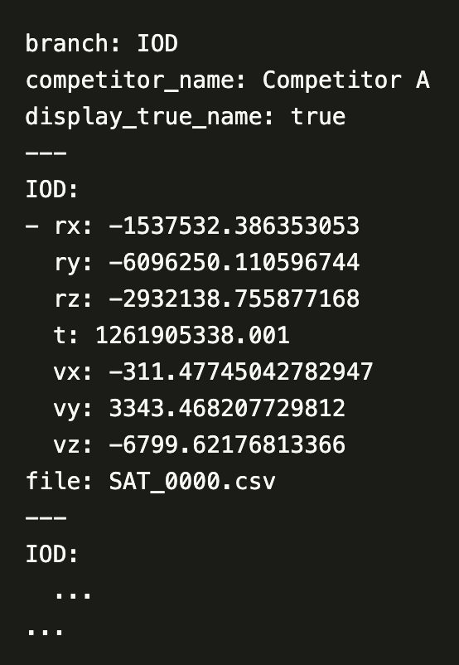
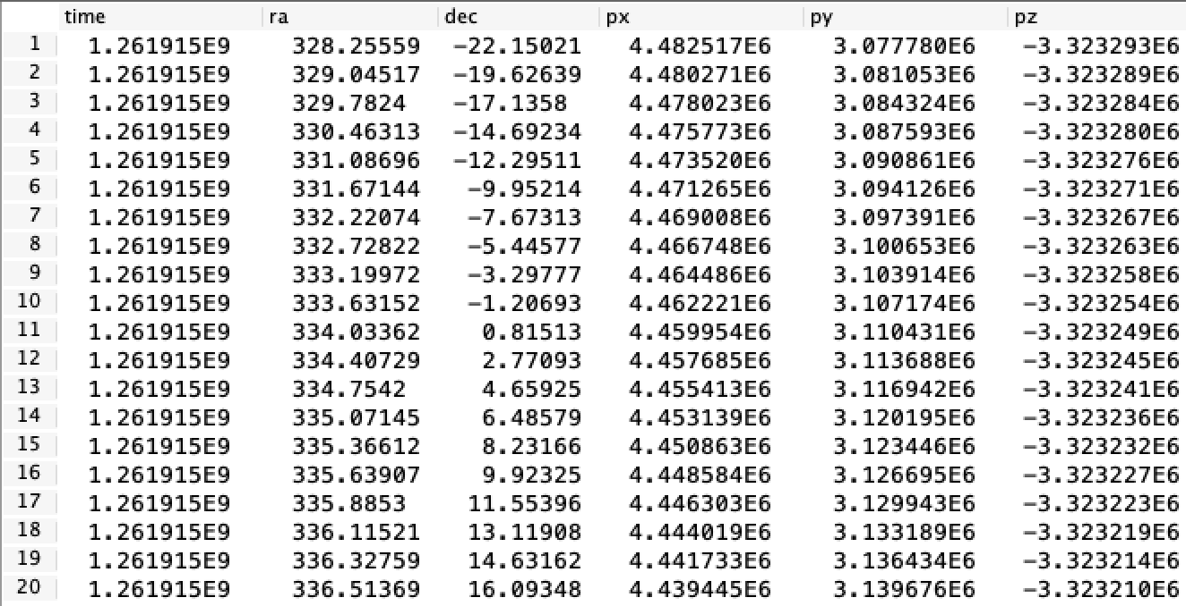
IOD Branch Structure
Example of minimum IOD submission file
1) Competitor is supplied
set of catalogs.
3) Competitor generates a submission file that gets returned for a score
Example IOD branch catalog
2) Competitor uses their algorithm to determine the information of interest
The "IOD" branch tests the competitors' ability to make accurate initial orbit determinations

Slide 10
IOD Branch Information Tests accuracies of initial orbit determinations, inferring positions and velocities from observations over a fraction of an orbital period
Branch Simulation
Optical, angle-only observations
Varying track lengths
Noise consistent with typical target-tracking images
Submission: For each target, the competitor is given a catalog with multiple observations, and asked to return:
The state (rx, ry, rz, vx, vy, vz) at time t
t = the time associated with the last observation (chronologically) in the .csv file
Supplying this for ALL targets is the minimum submission criteria to receive a score
Downrange locations (optional)
Ra and dec of target 5, 15, 30, and 60 minutes downrange
Predicted location covariance matrix (optional)
State vector covariance matrix (optional)
If downrange locations are not supplied, we use the SGP4 propagator to propagate forward to 5, 15, 30, and 60 minutes

Slide 11
IOD Branch Scoring Metrics
Root mean square error (RMSE) scores
rx, ry, rz, vx, vy, vz
Determined from the supplied state
Propagated scores
5, 15, 30, and 60 minutes downrange
For SGP4 propagator and/or your submitted downrange locations
Score determined by how many targets are within FOV at propagated time
Determined using angular distance from truth position at that time
Statistic scores
Cramer Von-Mises probabilities:
Downrange positions and state estimate
Describe how well errors match uncertainties
Z-scores:
One score for each of 5 quantiles
Compares empirical quantiles to those expected for a Gaussian or normal distribution

Slide 12
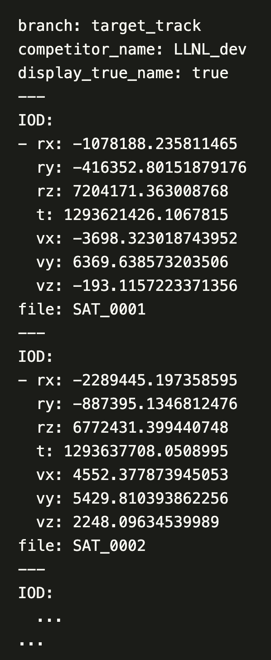
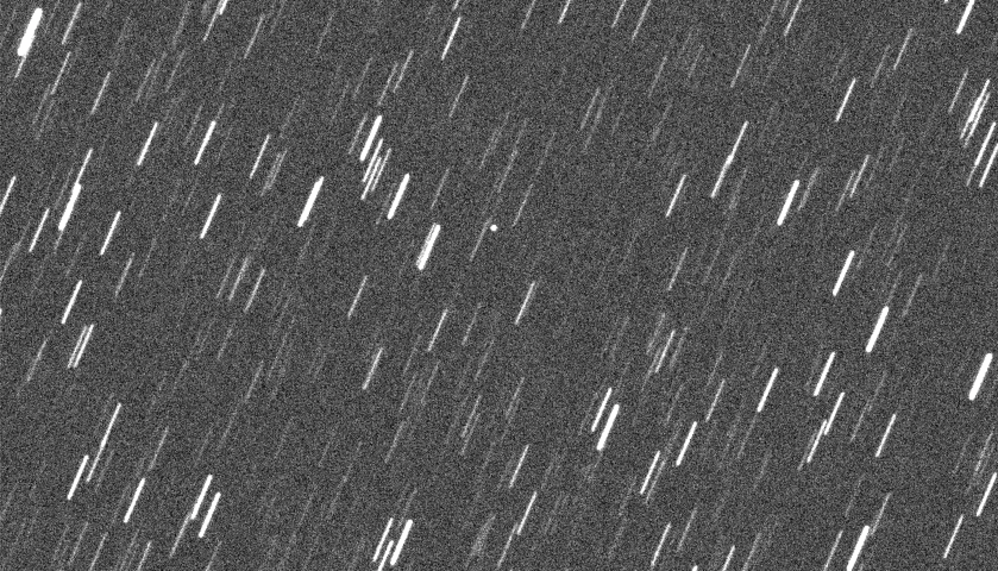
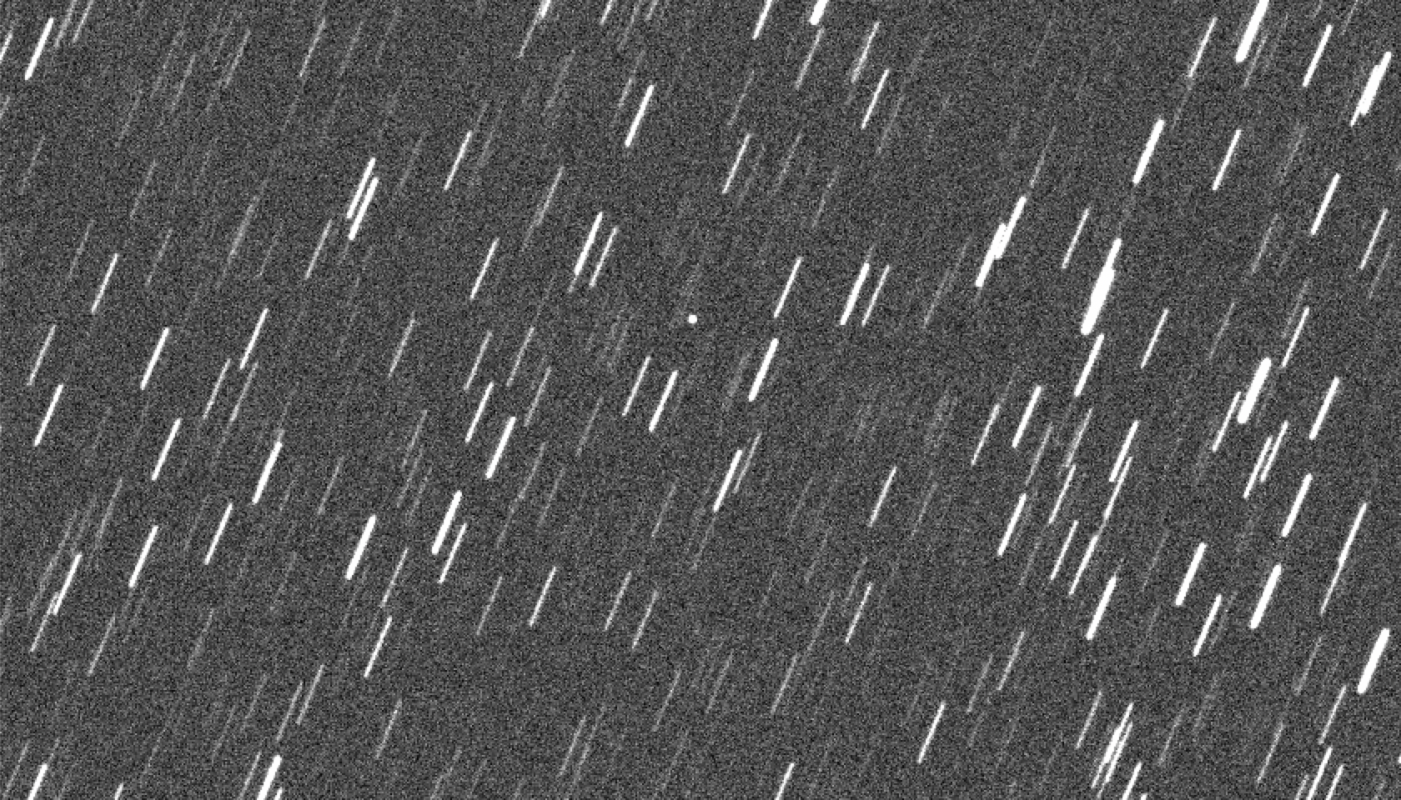
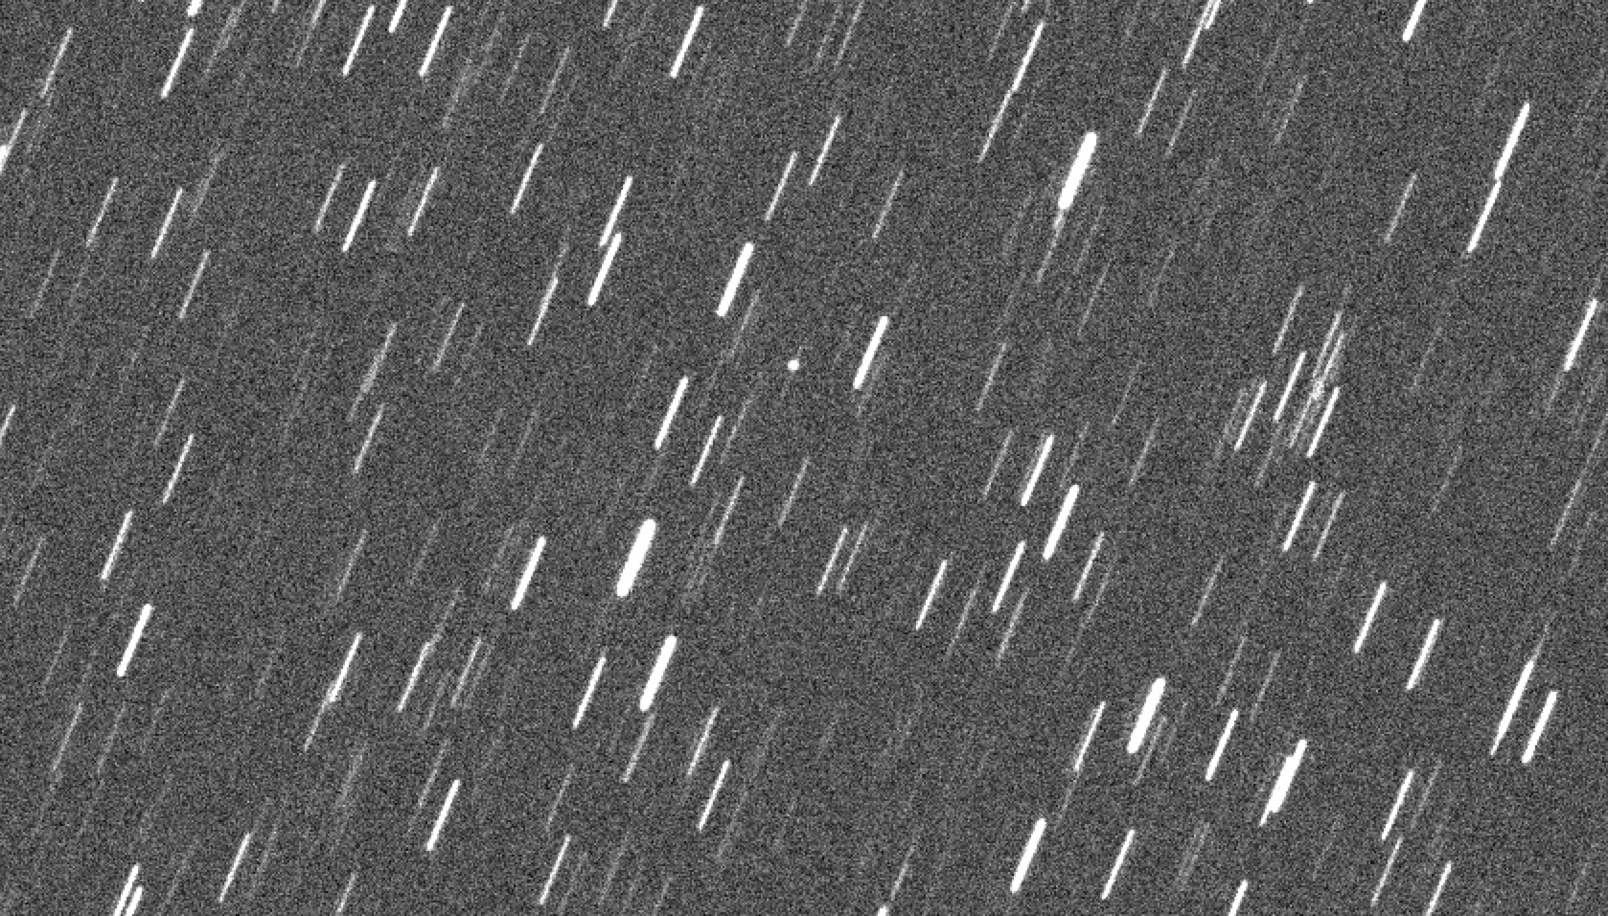
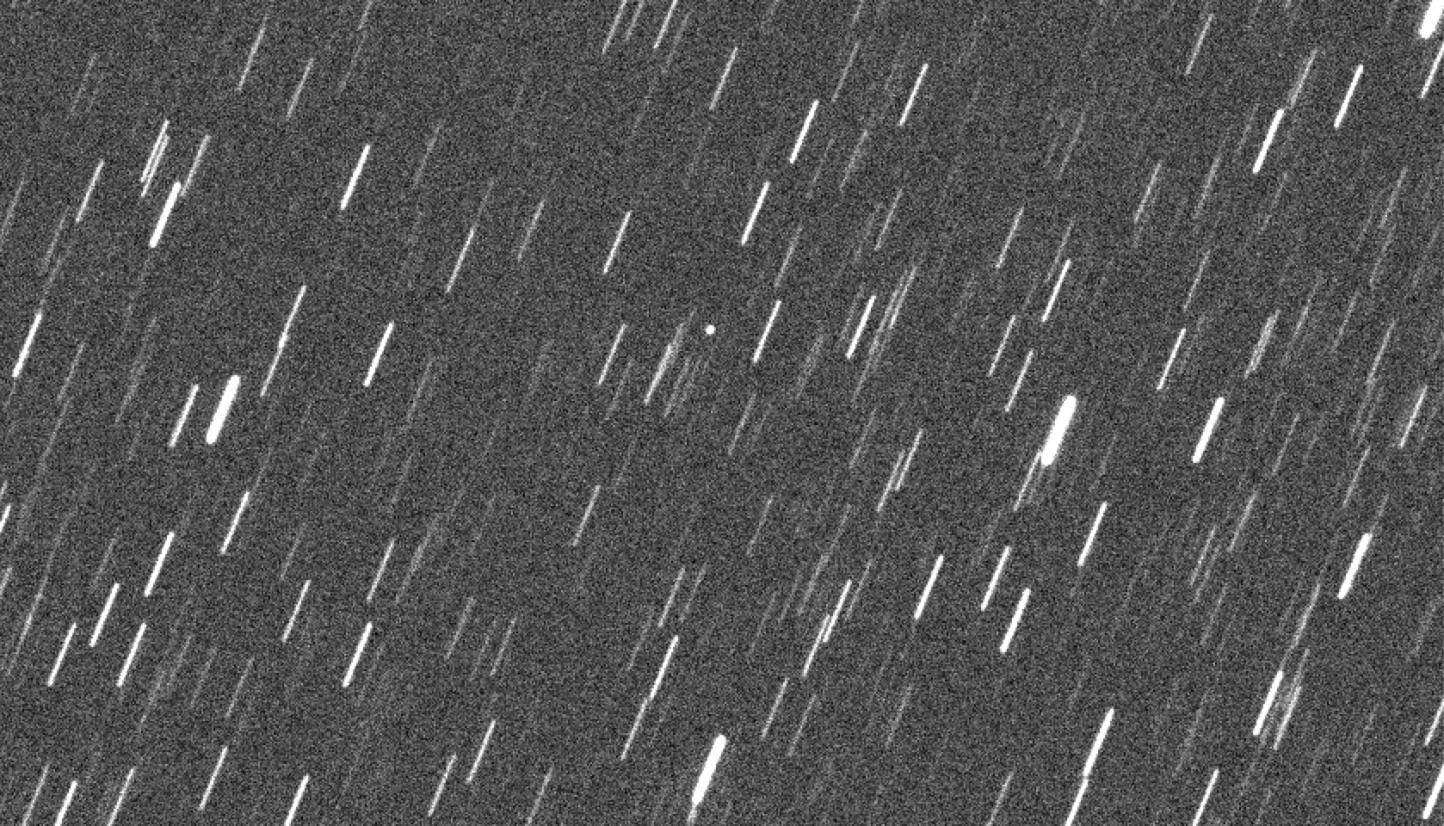
Target Track/Sidereal Track Branch Structure
3) Competitor generates a submission file that gets returned for a score
1) Competitor is supplied sets of "stacked" images (per branch)
2) Competitor uses their algorithm to determine the information of interest
Example Target Track branch image stack with 4 observations
The "Target Track" and "Sidereal Track" branches test the competitor on the full set of SDA tasks

Slide 13
Target Track/Sidereal Track Branch Information Tests ability to detect and track target through multiple observations, and on accuracy of initial orbit determination
Simulation:
In addition to the features mentioned on the Target/Sidereal slides, we:
Generate ephemerides for LEO satellites (by sampling randomly from public catalogs)
Uniformly sample size and albedo
A network of 20 ground stations observe the satellite:
As the satellite passes over each station, its coordinates as seen from each station are computed and images are taken every X seconds along the track.
Submission:
Requirements are identical to the IOD branch:
The user is asked to return the state (rx, ry, rz, vx, vy, vz) at time t
t = the time associated with the shutter open time of the last observation (chronologically)
Supplying this for ALL targets is the minimum submission criteria to receive a score
Downrange locations, predicted location covariance matrices, and state vector covariance matrices are optional as in the IOD branch. (See the IOD Scoring Metrics slide for more information).

Slide 14
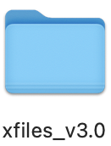
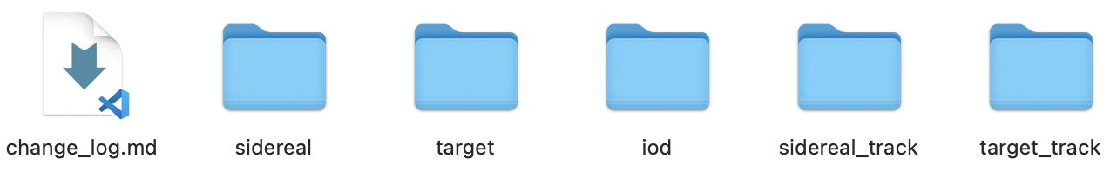
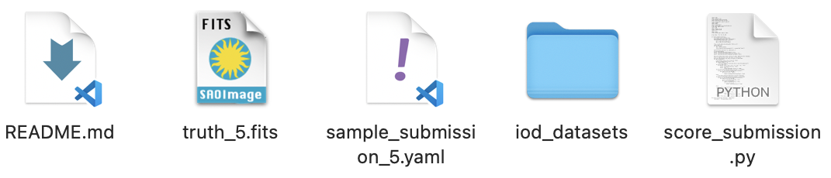
Distribution Structure
For the competitor
Folder of input data
Target*/Sidereal* = FITS format images
IOD = .csv format catalogs
Truth table for first few input data
FITS format, with extensions with star and sat info
Sample submission file
YAML file demonstrating correct submission format
Script to check and score submission
Python script for verifying submission format, and testing scoring on first few input data
Documentation
Markdown files that describe data simulation, file structure, expected submission format, and scores.
For X-Files team private use
Truth table for ALL input data
All simulation scripts
Example File Structure – IOD Branch
Filled with all IOD catalogs

Slide 15
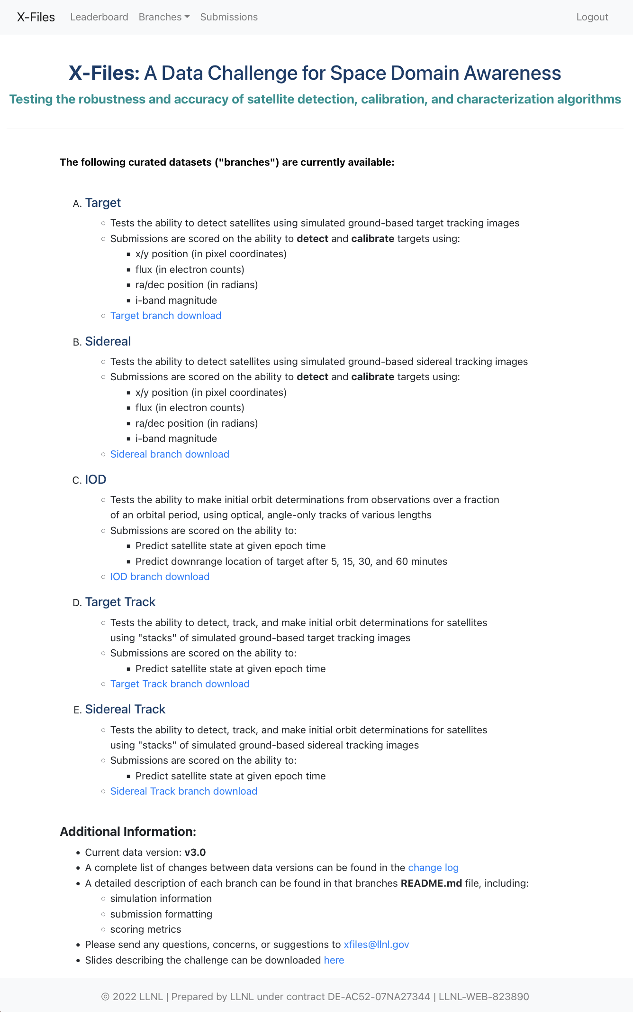
X-Files Dashboard A visual interface for understanding scores
https://xfiles.llnl.gov brings the user to the info page that describes the challenge and has downloadable links for each data set.
Upon submission, scores will be added to the dashboard.
Note: There is an option to remain anonymous.
Each competitor has their own page (per branch) to visualize their scores, as well as access to all other competitors pages.
If your score beats a current high score, you will be featured on the leaderboard.
Interactive plots for further analysis
Show off your score on the X-Files leaderboard

Slide 16
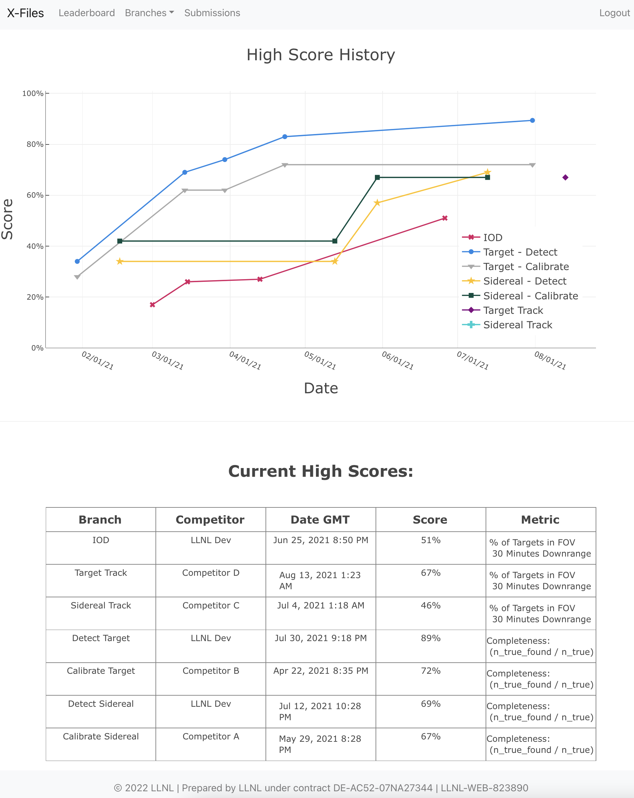
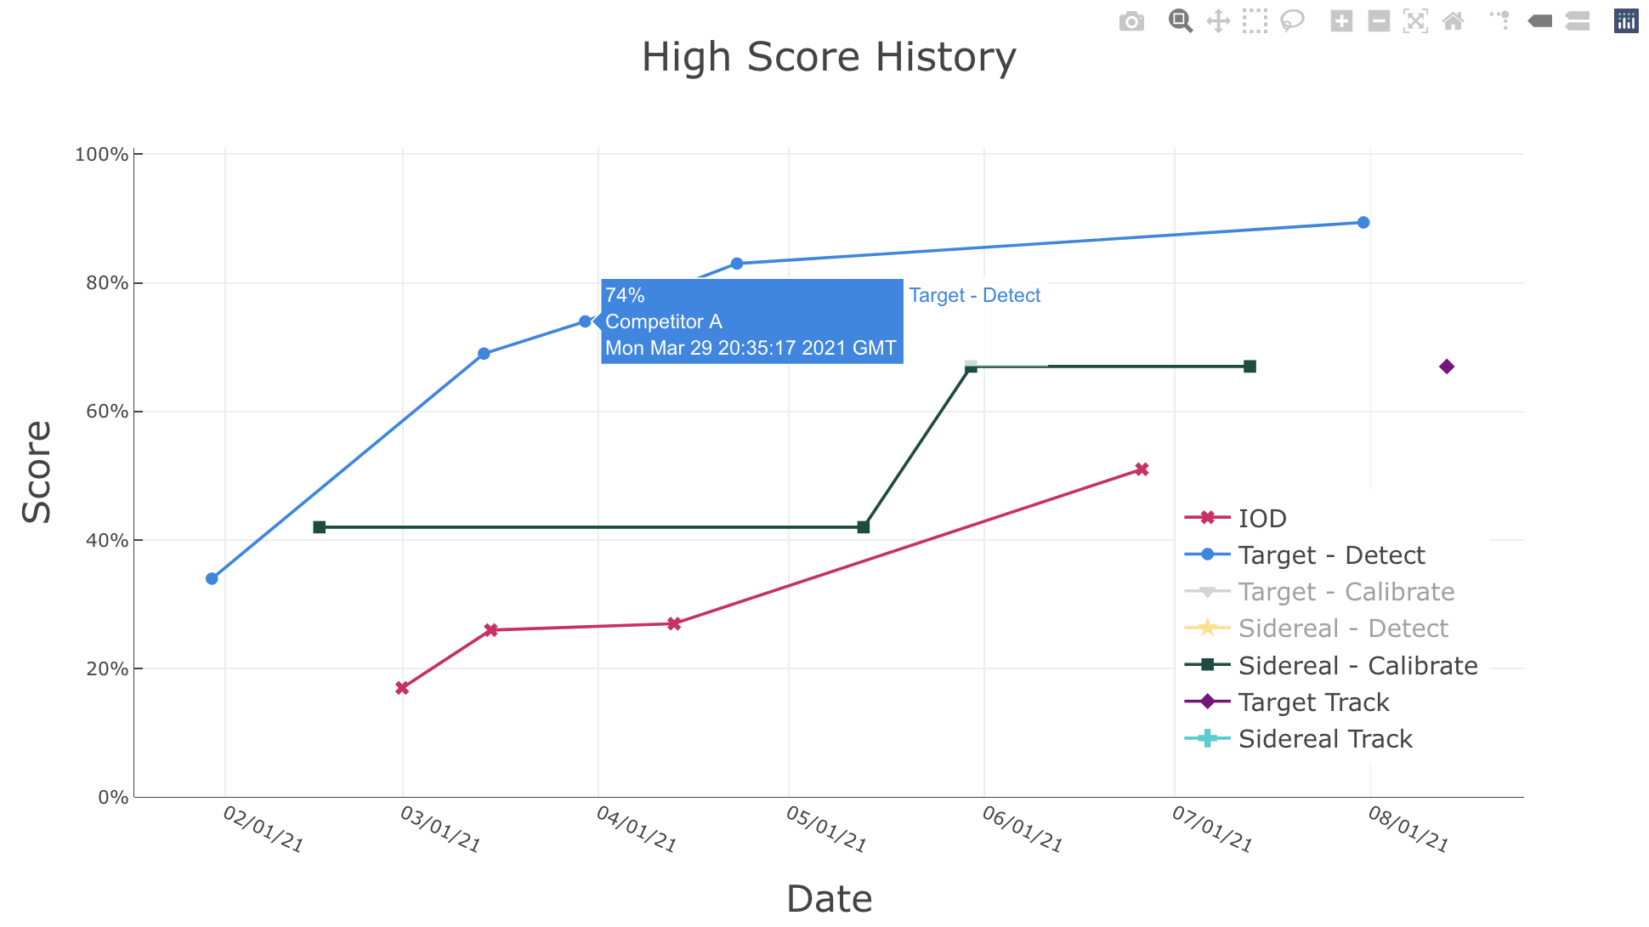


Leaderboard
The leaderboard includes:
A Plot that reflects the overall high score, per branch, as a function of time
A Table featuring the leading score per branch
Plot tools:
Hovering over points reveal score, competitor, and data associated with each high score
Hovering over a plot brings up an interactive toolbar for manipulating plots
Save, zoom, pan, lasso, etc.
Clicking a branch on the legend hides those scores

Slide 17
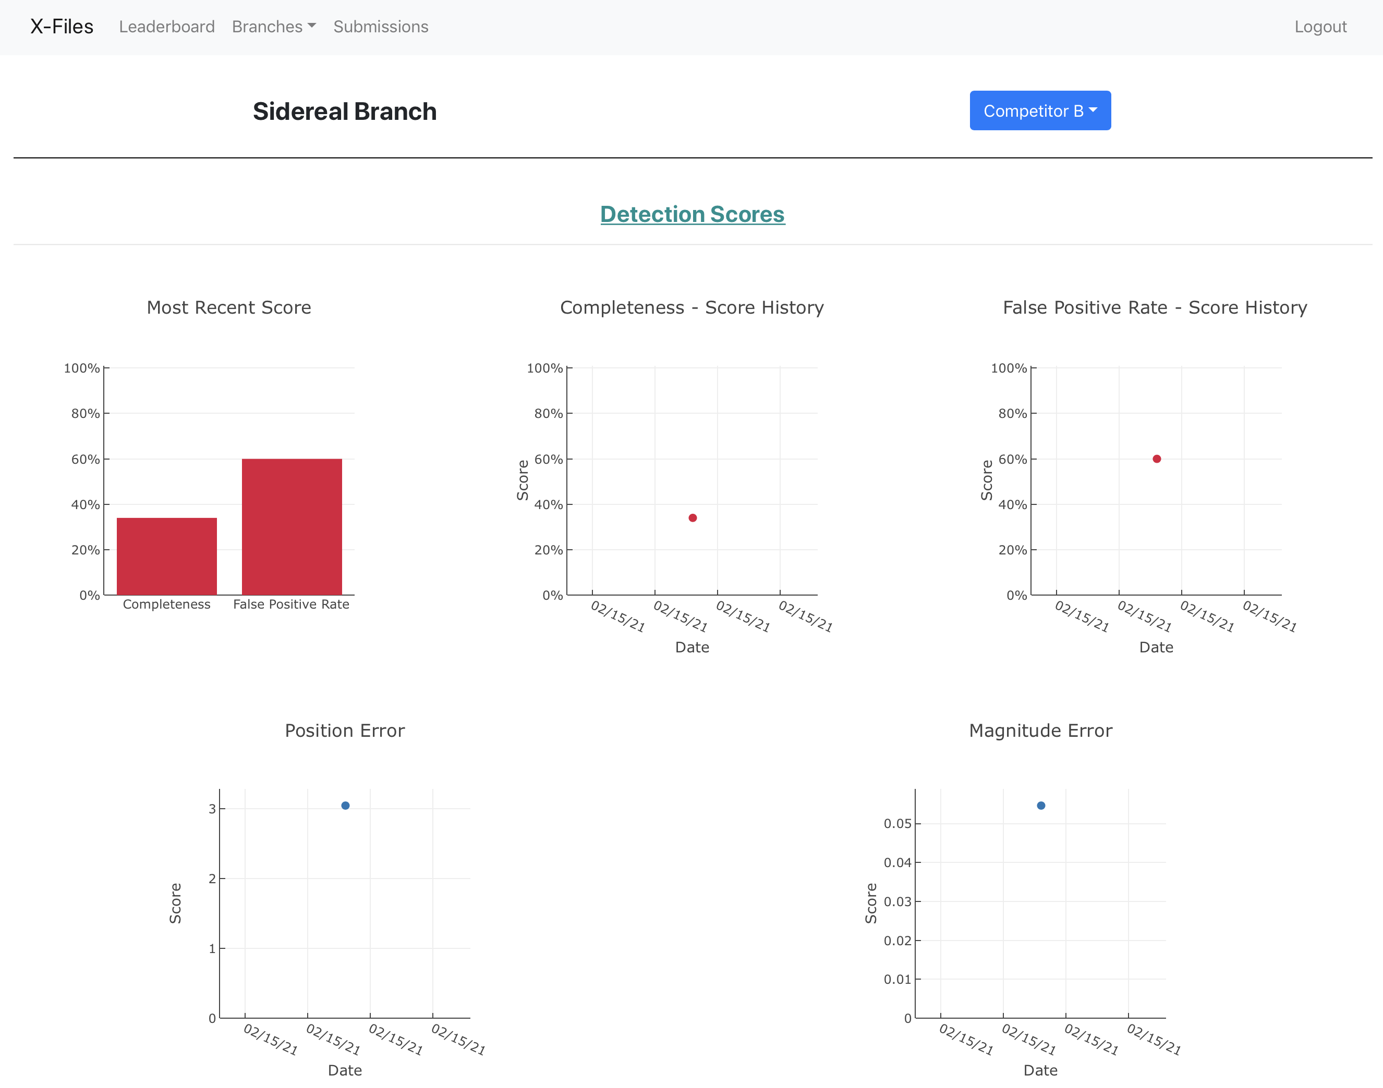
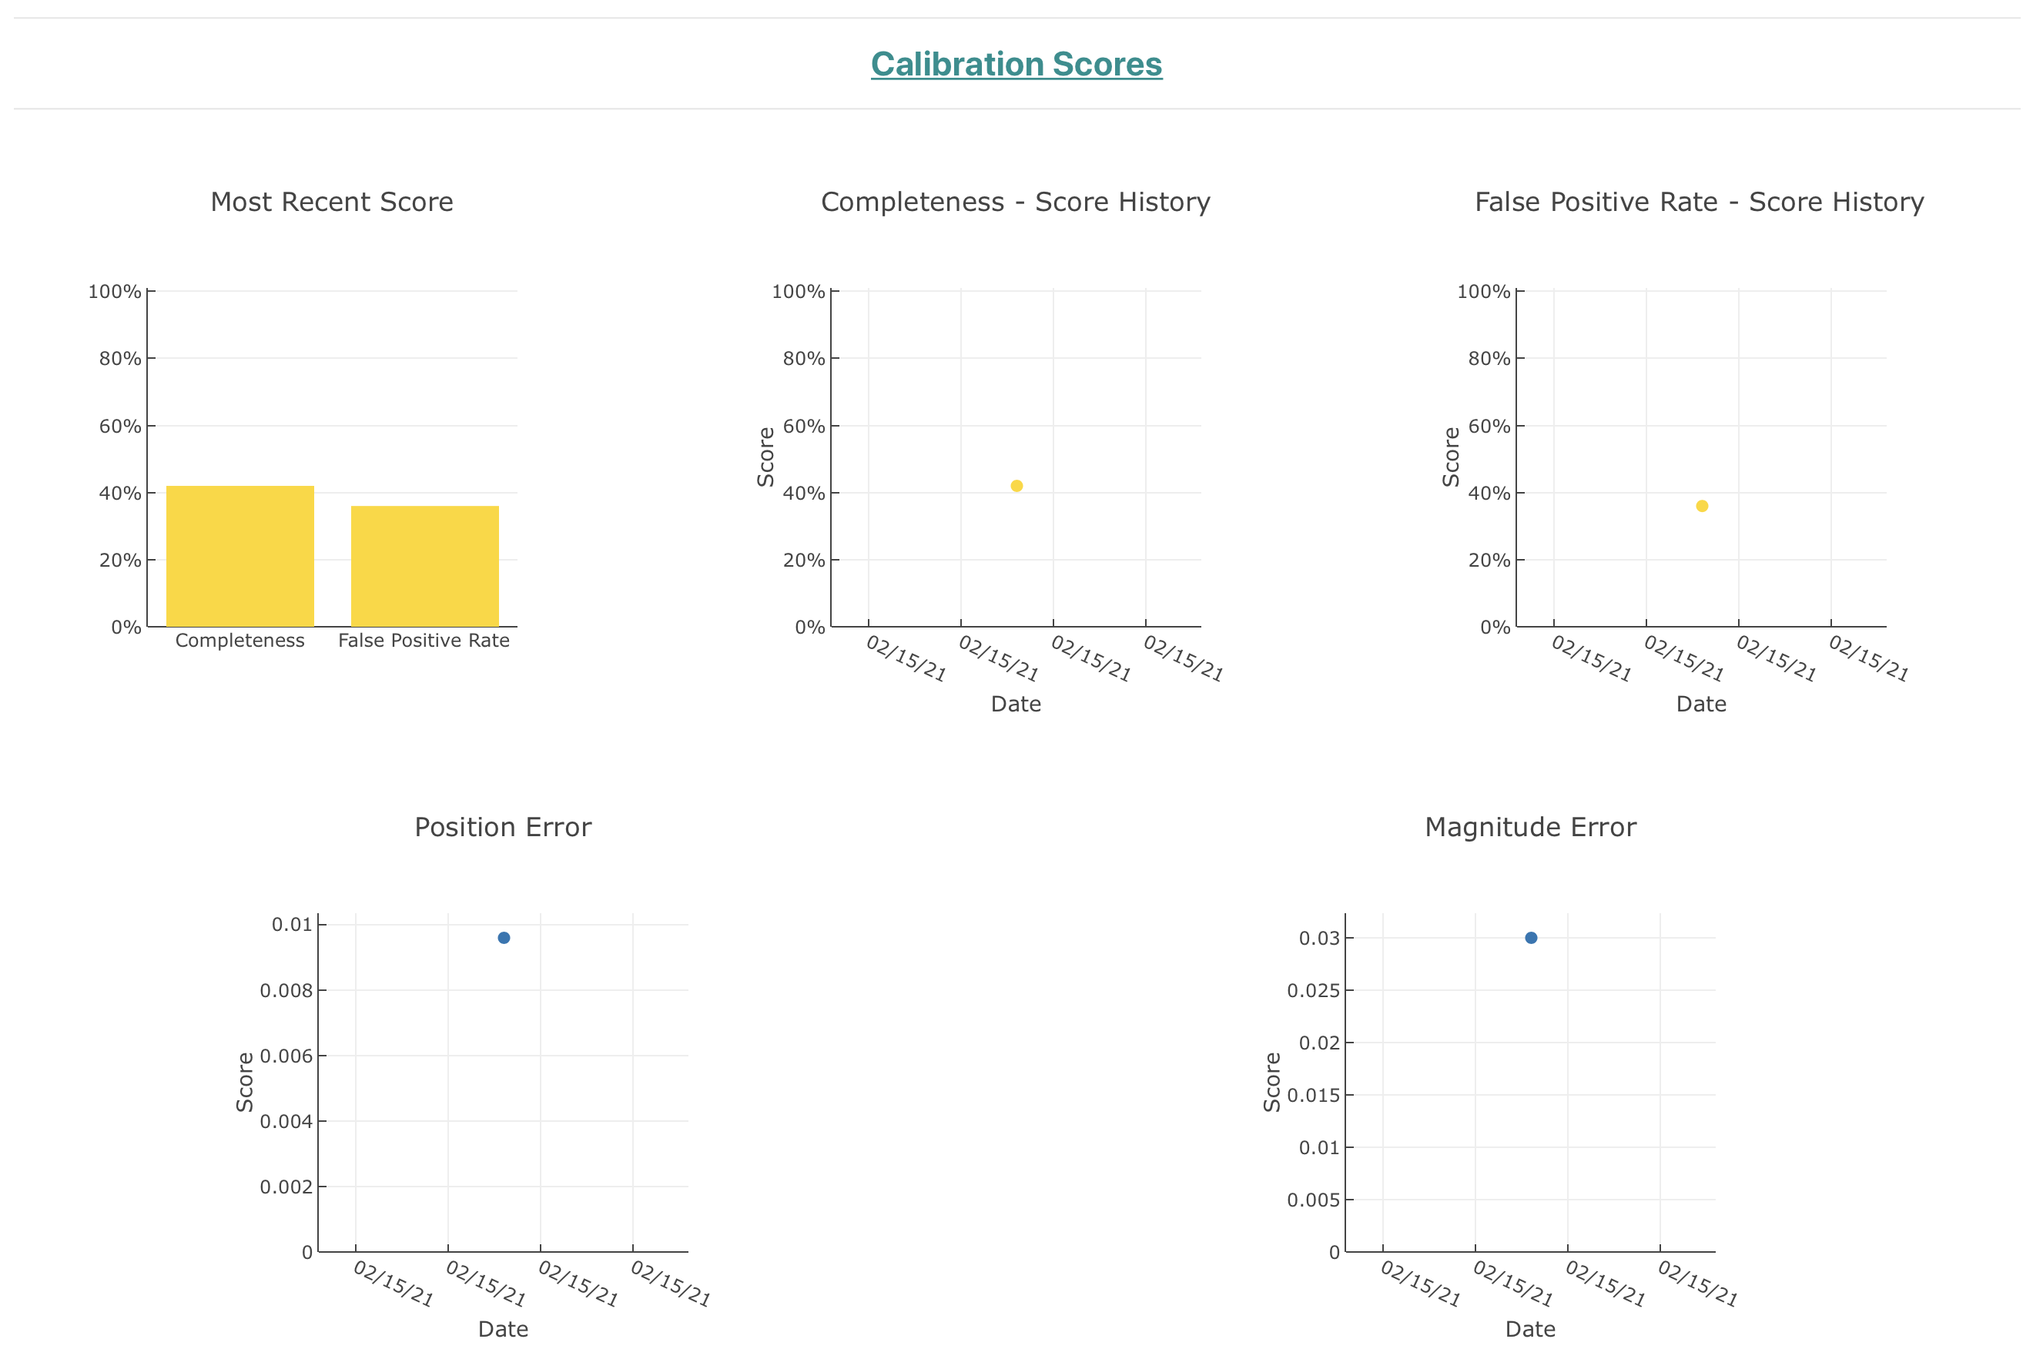
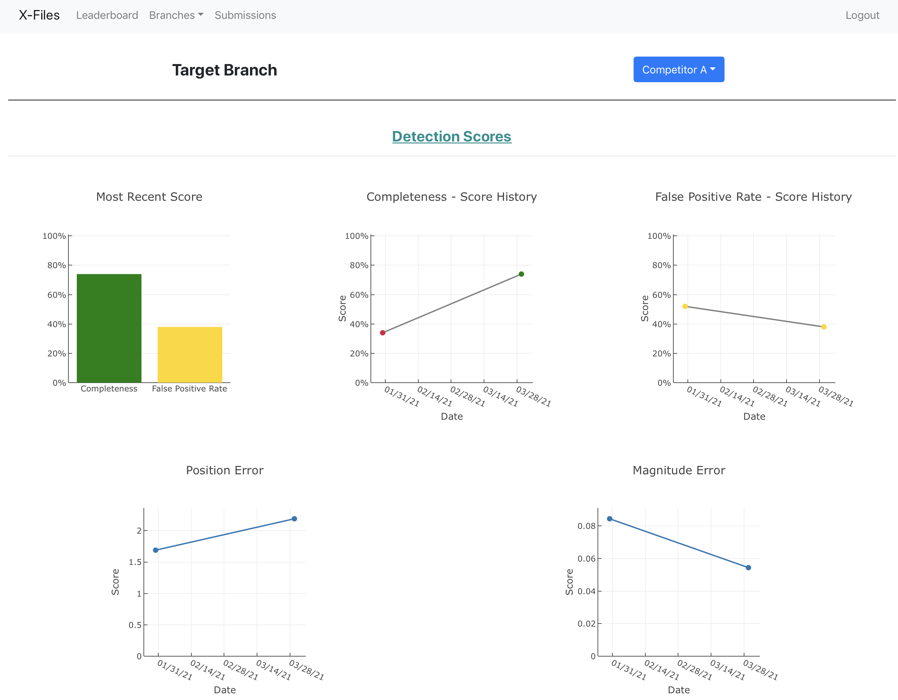
Branch Tab: Target/Sidereal
ALL branch tabs have a competitor drop-down menu in which you can select which competitor scores to display
The Target and Sidereal branches are both split into 2 sections:
Detection
x/y/flux
Calibration
Ra/dec/mag
Plots include:
Completeness
FPR
RMSE errors

Slide 18
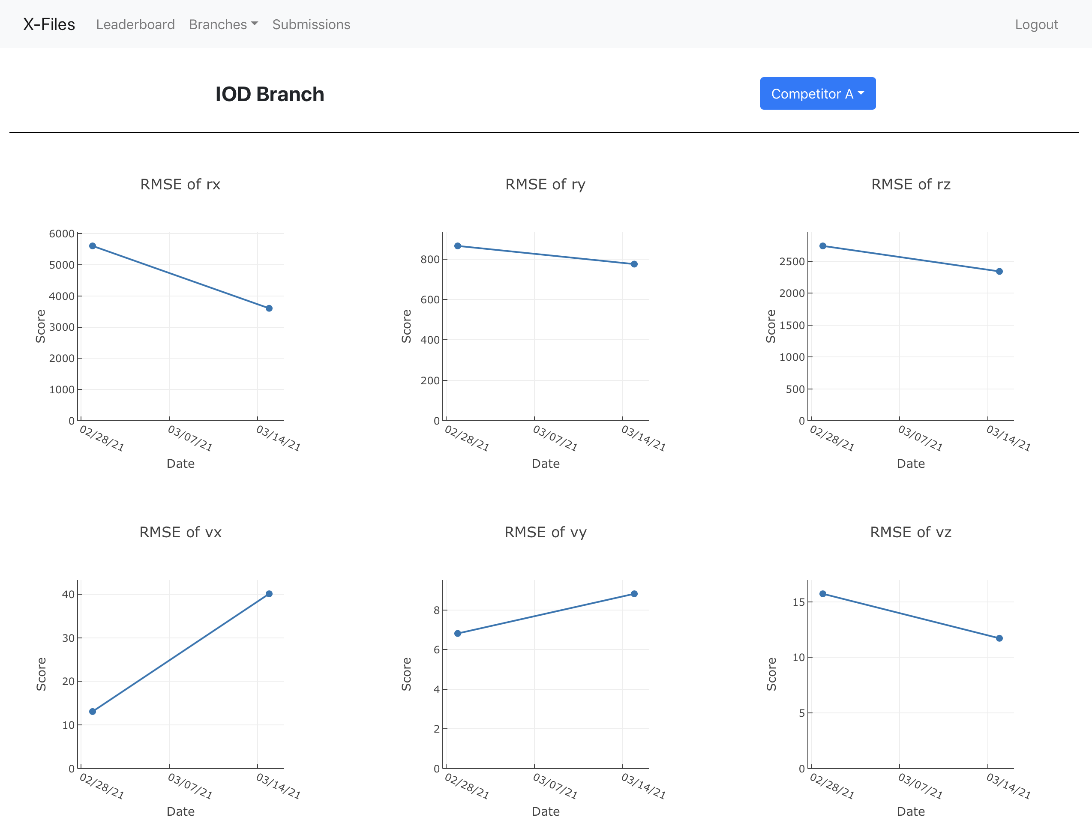
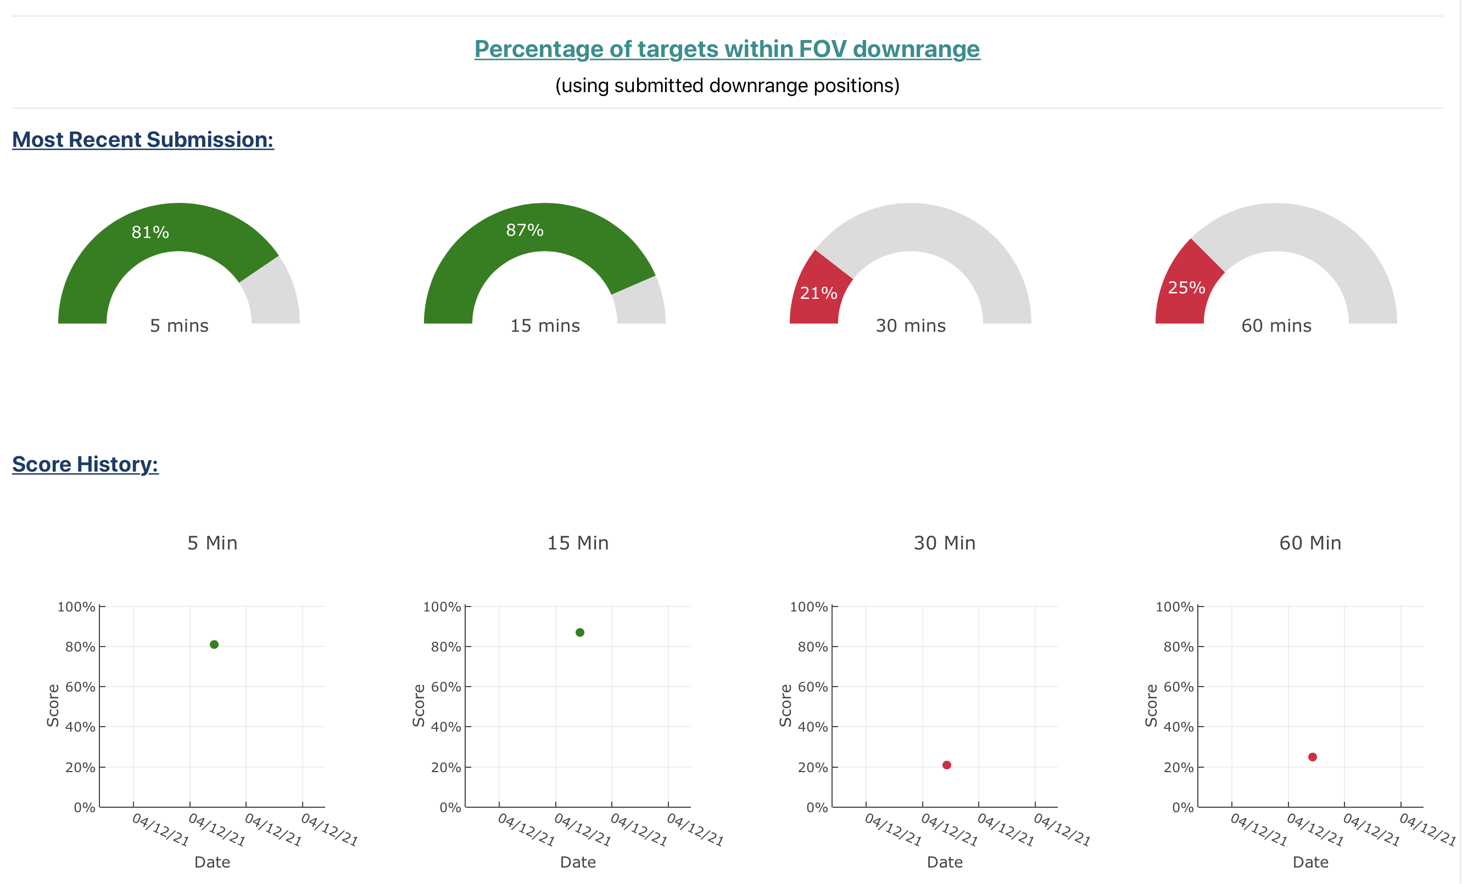
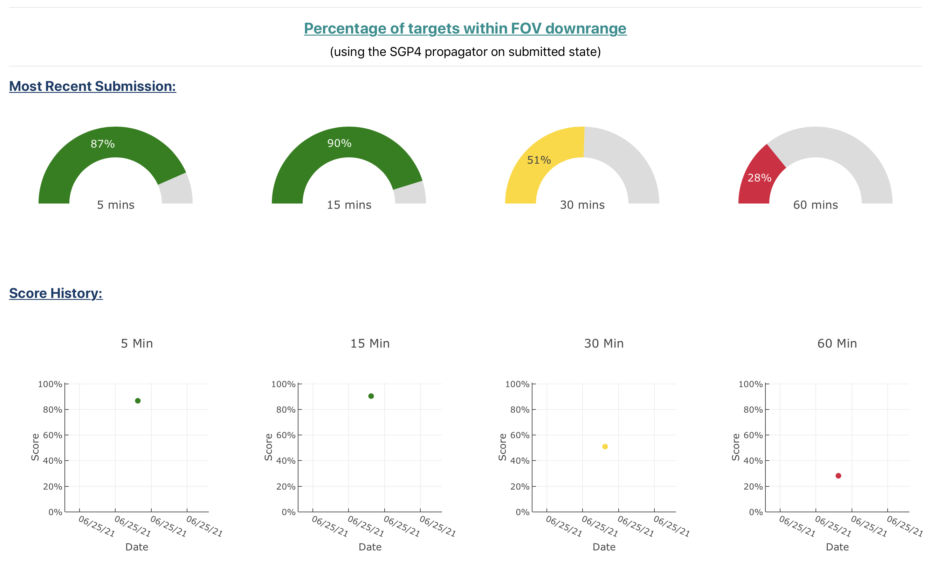
Branch Tab: IOD
The IOD tab contains plots for visualizing various IOD scores:
RMSE errors
State estimate accuracy
% of targets within FOV at various times downrange

Slide 19
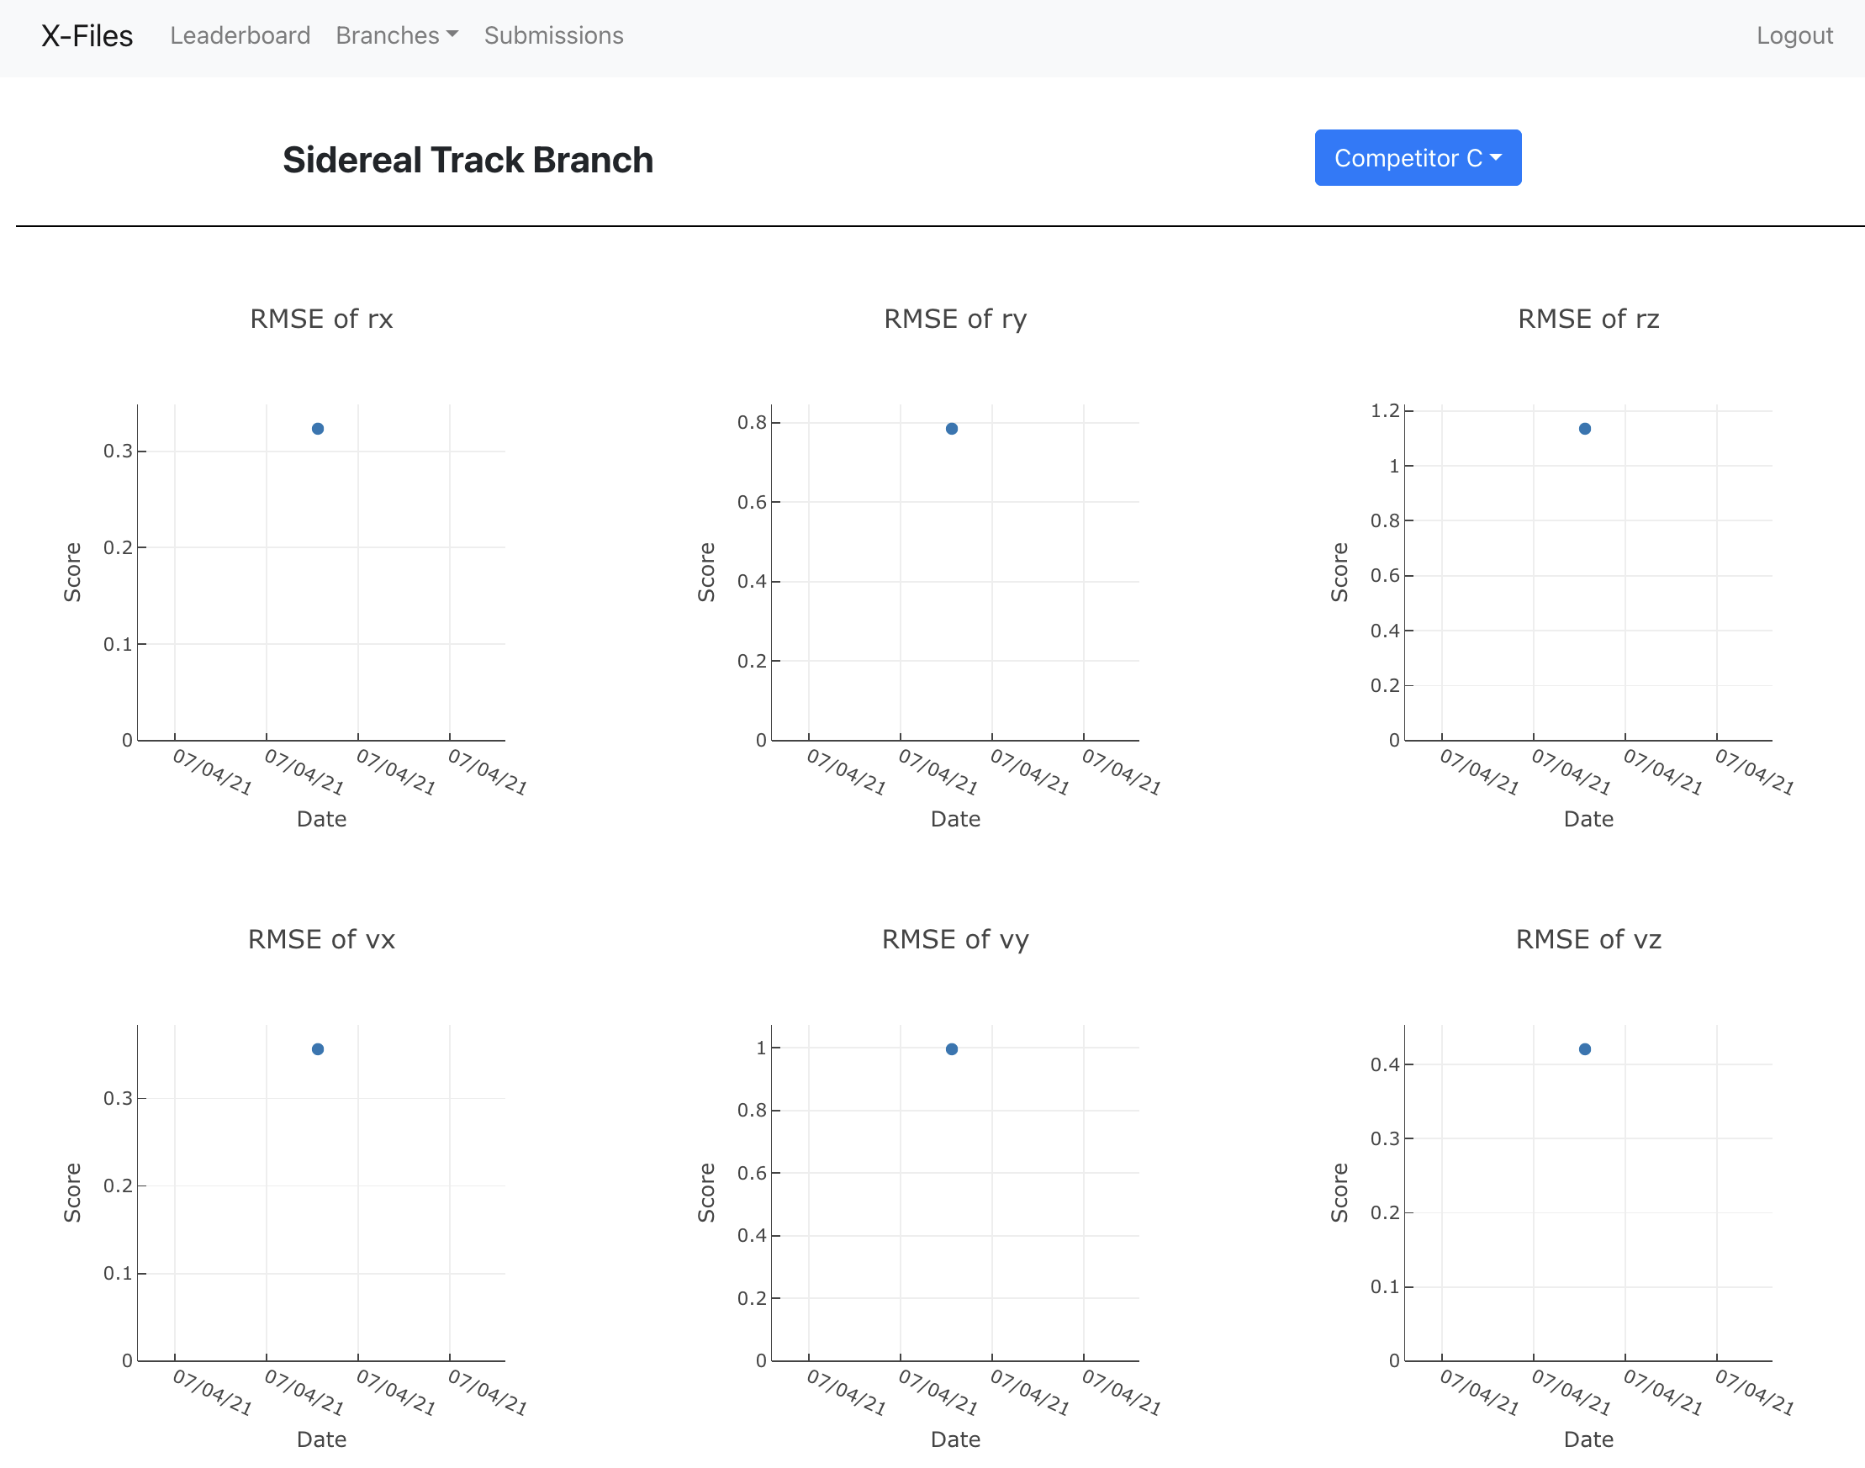
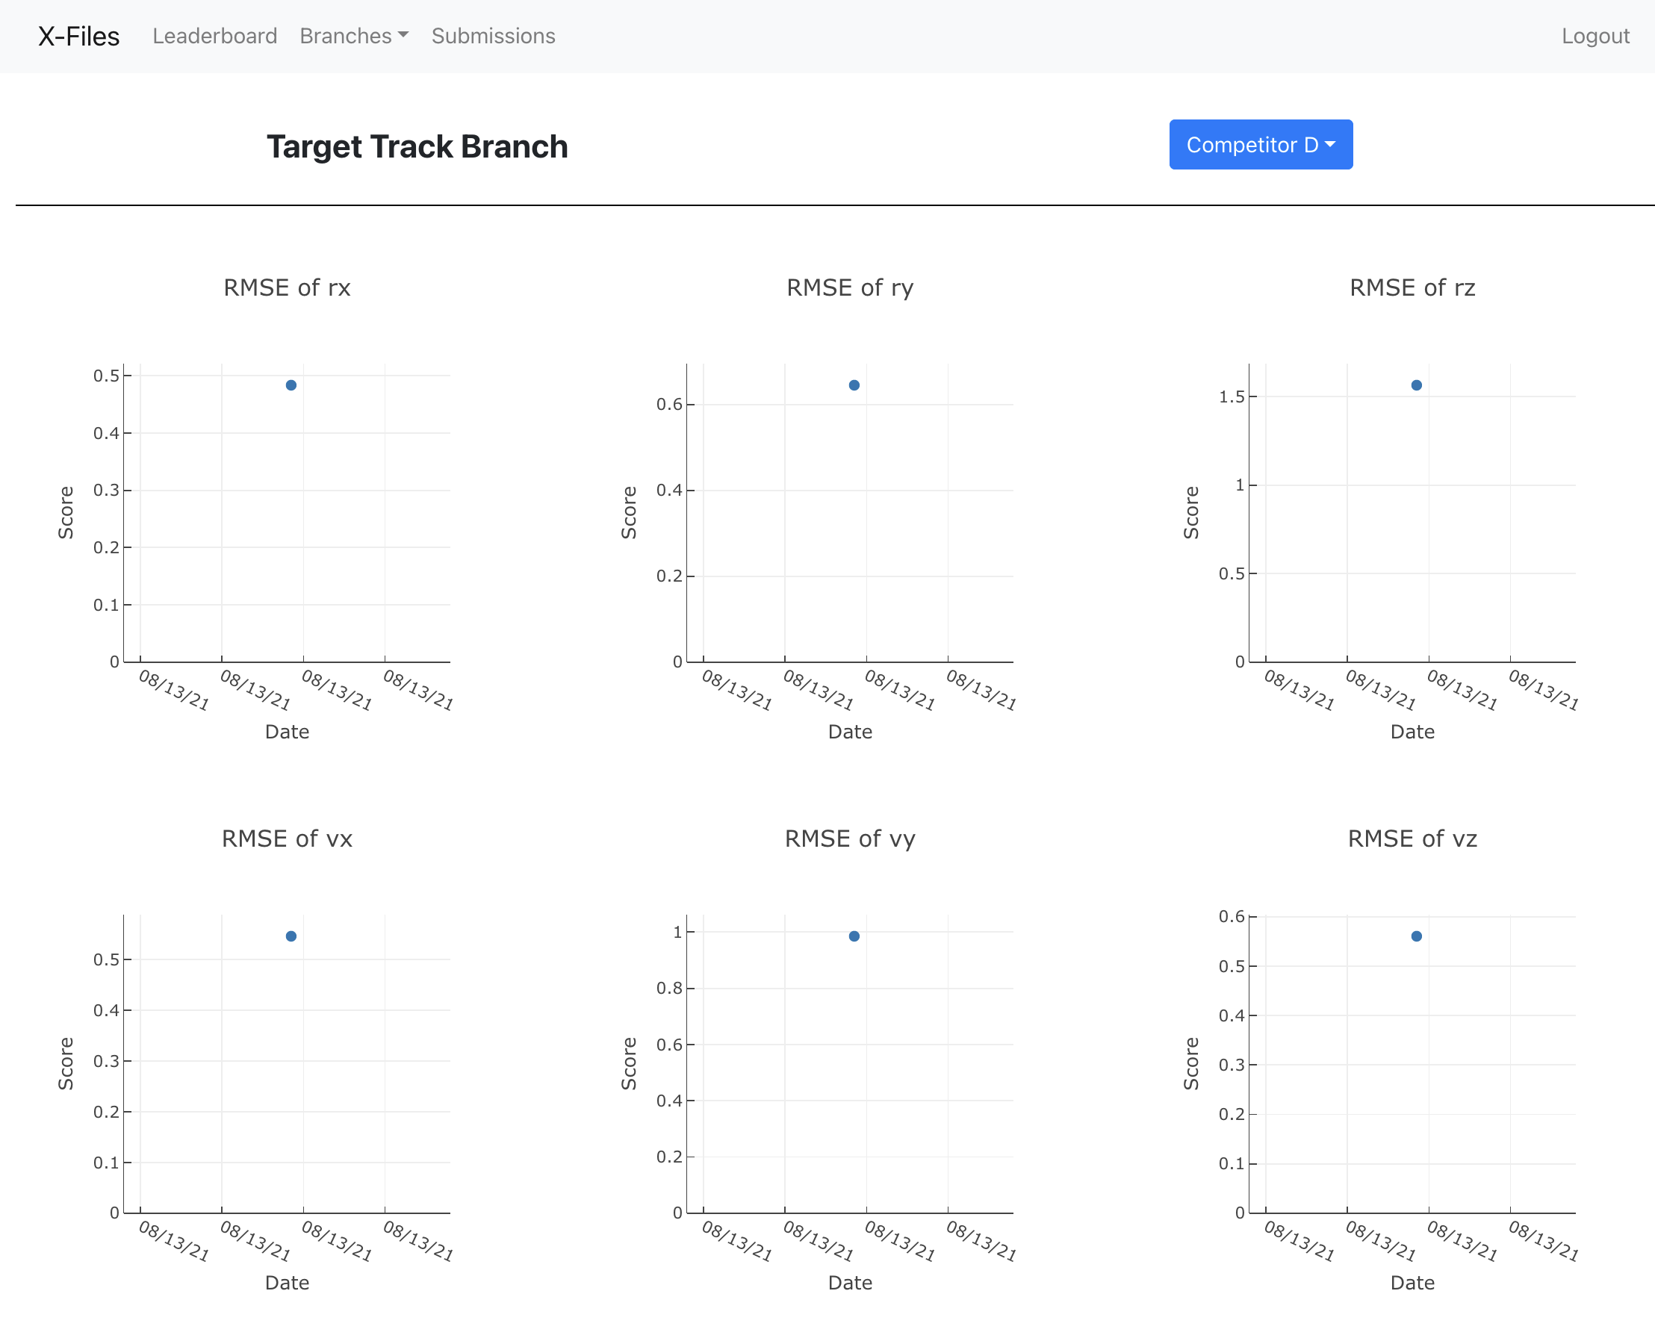
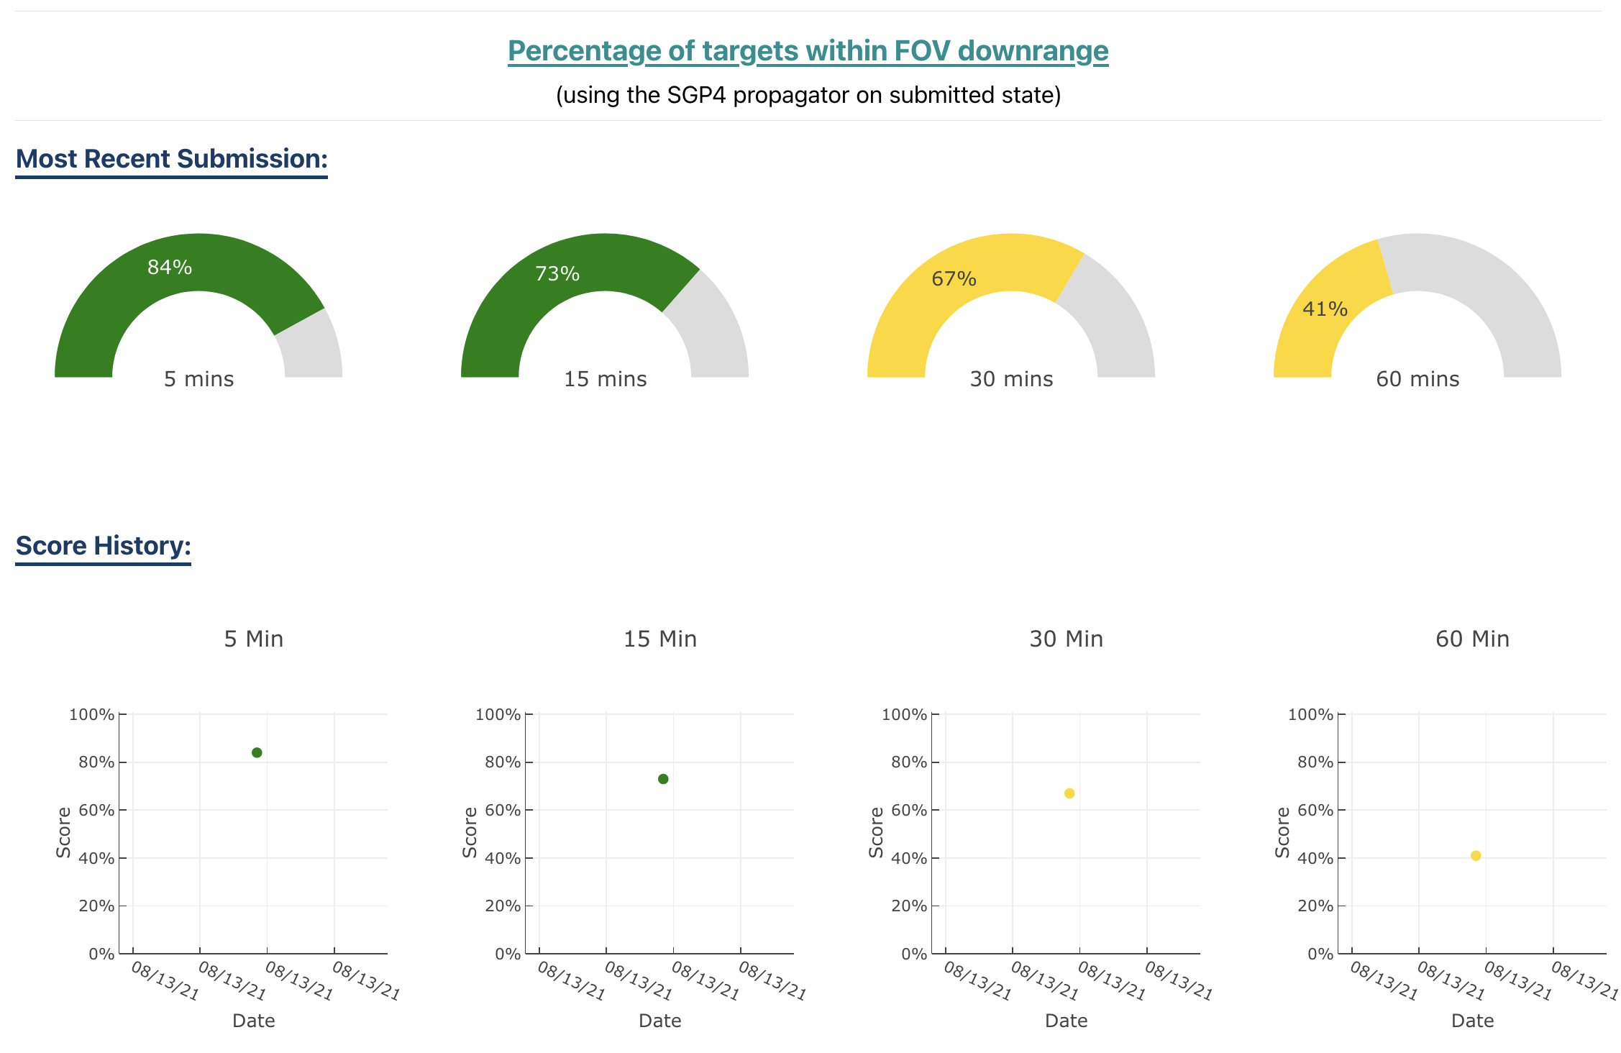
Branch Tab: Target Track / Sidereal Track
The "Track" branches contain plots for visualizing various scores:
RMSE errors
State estimate accuracy
% of targets within FOV at various times downrange

Slide 20
Participation
Who can participate?
Anyone can participate!
How to participate?
Expressing interest:
If you are interested in competing in the X-Files data challenge, send an email to xfiles@llnl.gov
Accessing the challenge:
Once your participation is approved, you will receive login information for https://xfiles.llnl.gov
Download the data and begin testing your algorithms
Return a submission to populate your score onto the dashboard
Why should you participate?
Gain attention for your SDA algorithms
Earn a government contract or financial reward*
*Rules apply

Slide 21
Coming Soon
Split branches by difficulty level
Target/Sidereal branches will have varying numbers of targets in each image
IOD branch will be further broken down by track length
”Full" branch will have maneuvers of varying difficulty to track / disambiguate. Images in a stack will have varying amounts of time before observations, and varying exposure times.
Dashboard features
Auto-scoring done through dashboard
Info tab describing each scoring metric
Interactive table allowing the user full control of data
Future Directions:
Data On-Demand
Generating custom data packages given satellite and ground-sensor parameters
Potentially a web page where the user can interact in order to set values, etc.
All-sky survey design and CONOPS for ground-based COTS optical

Slide 22
Disclaimer
This document was prepared as an account of work sponsored by an agency of the United States government. Neither the United States government nor Lawrence Livermore National Security, LLC, nor any of their employees makes any warranty, expressed or implied, or assumes any legal liability or responsibility for the accuracy, completeness, or usefulness of any information, apparatus, product, or process disclosed, or represents that its use would not infringe privately owned rights. Reference herein to any specific commercial product, process, or service by trade name, trademark, manufacturer, or otherwise does not necessarily constitute or imply its endorsement, recommendation, or favoring by the United States government or Lawrence Livermore National Security, LLC. The views and opinions of authors expressed herein do not necessarily state or reflect those of the United States government or Lawrence Livermore National Security, LLC, and shall not be used for advertising or product endorsement purposes.

